Slide 1
ECON1002 Intro. Macro.
Tutorial 11
Herbert Xin
wei.xin@sydney.edu.au

Slide 2
Plan of Today
Concept Review
Tutorial Questions
Essay Task
More info on FAQs
Due: May 11th

Slide 3
Concept Review

Slide 4
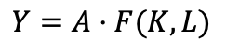
Solow Swan Model – Production Function
Production function
$$Y=A⋅F(K,L)$$

Slide 5
Solow Swan Model – Production Function
Production function
$$Y=A⋅F(K,L)$$
Constant return to increase in both variables
Diminishing return to increase in single variable

Slide 6
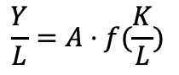
Solow Swan Model – Production Function
Production function
Per-capita production function
$$\frac{Y}{L}=A⋅f(\frac{K}{L})$$
$$Y=A⋅F(K,L)$$
Constant return to increase in both variables
Diminishing return to increase in single variable

Slide 7
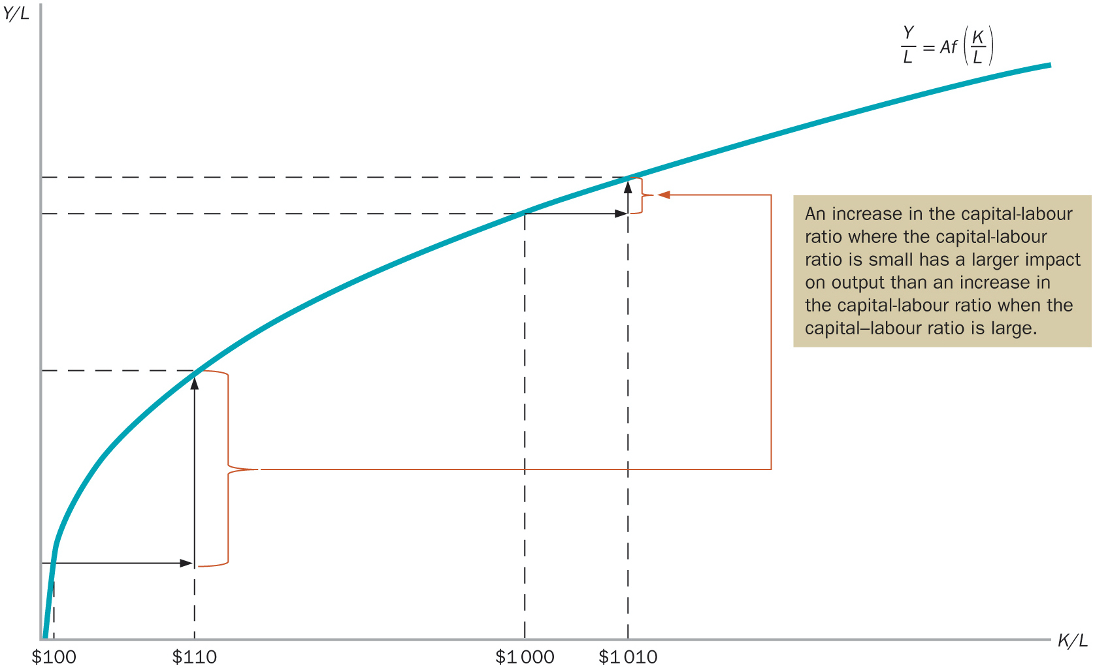
Solow Swan Model – Production Function
Production function
Per-capita production function
$$\frac{Y}{L}=A⋅f(\frac{K}{L})$$
$$Y=A⋅F(K,L)$$
Constant return to increase in both variables
Diminishing return to increase in single variable

Slide 8
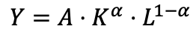
Solow Swan Model – Production Function
Production function
Per-capita production function
$$\frac{Y}{L}=A⋅f(\frac{K}{L})$$
$$Y=A⋅F(K,L)$$
Constant return to increase in both variables
Diminishing return to increase in single variable
Cobb-Douglas example
$$Y=A⋅K^{α}⋅L^{1−α}$$

Slide 9
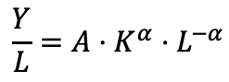
Solow Swan Model – Production Function
Production function
Per-capita production function
$$\frac{Y}{L}=A⋅f(\frac{K}{L})$$
$$Y=A⋅F(K,L)$$
Constant return to increase in both variables
Diminishing return to increase in single variable
Cobb-Douglas example
$$\frac{Y}{L}=A⋅K^{α}⋅L^{−α}$$
$$Y=A⋅K^{α}⋅L^{1−α}$$

Slide 10
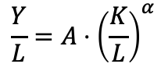
Solow Swan Model – Production Function
Production function
Per-capita production function
$$\frac{Y}{L}=A⋅f(\frac{K}{L})$$
$$Y=A⋅F(K,L)$$
Constant return to increase in both variables
Diminishing return to increase in single variable
Cobb-Douglas example
$$\frac{Y}{L}=A⋅K^{α}⋅L^{−α}$$
$$Y=A⋅K^{α}⋅L^{1−α}$$
$$\frac{Y}{L}=A⋅{\left(\frac{K}{L}\right)}^{α}$$

Slide 11
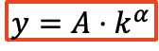
Solow Swan Model – Production Function
Production function
Per-capita production function
$$\frac{Y}{L}=A⋅f(\frac{K}{L})$$
$$Y=A⋅F(K,L)$$
Constant return to increase in both variables
Diminishing return to increase in single variable
Cobb-Douglas example
$$\frac{Y}{L}=A⋅K^{α}⋅L^{−α}$$
$$Y=A⋅K^{α}⋅L^{1−α}$$
$$\frac{Y}{L}=A⋅{\left(\frac{K}{L}\right)}^{α}$$
$$y=A⋅k^{α}$$

Slide 12
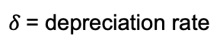
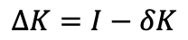
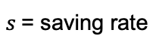
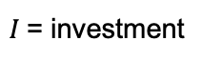
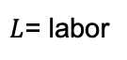
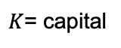
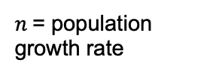
Capital Accumulation
Notation
$$ΔK=I−δK$$
$K$= capital
$L$= labor
$I$= investment
$s$= saving rate
$δ$= depreciation rate
$n$= population growth rate

Slide 13
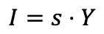
Capital Accumulation
Notation
$$ΔK=I−δK$$
$K$= capital
$$I=s⋅Y$$
$L$= labor
$I$= investment
$s$= saving rate
$δ$= depreciation rate
$n$= population growth rate

Slide 14
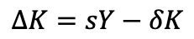
Capital Accumulation
Notation
$$ΔK=I−δK$$
$K$= capital
$$I=s⋅Y$$
$L$= labor
$$ΔK=sY−δK$$
$I$= investment
$s$= saving rate
$δ$= depreciation rate
$n$= population growth rate

Slide 15
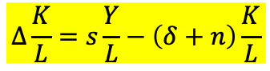
Capital Accumulation
Notation
$$ΔK=I−δK$$
$K$= capital
$$I=s⋅Y$$
$L$= labor
$$ΔK=sY−δK$$
$I$= investment
$s$= saving rate
$$Δ\frac{K}{L}=s\frac{Y}{L}−\left(δ+n\right)\frac{K}{L}$$
$δ$= depreciation rate
$n$= population growth rate

Slide 16
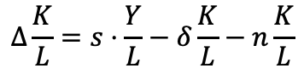
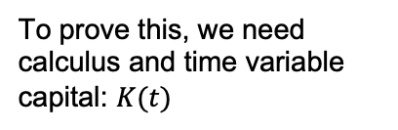
Capital Accumulation
Notation
$$ΔK=I−δK$$
$$Δ\frac{K}{L}=s⋅\frac{Y}{L}−δ\frac{K}{L}−n\frac{K}{L}$$
$K$= capital
$$I=s⋅Y$$
$L$= labor
$$ΔK=sY−δK$$
To prove this, we need calculus and time variable capital: $K(t)$
$I$= investment
$s$= saving rate
$$Δ\frac{K}{L}=s\frac{Y}{L}−\left(δ+n\right)\frac{K}{L}$$
$δ$= depreciation rate
$n$= population growth rate

Slide 17
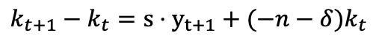
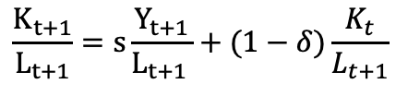
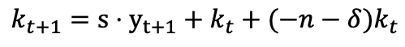
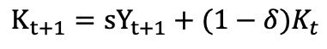
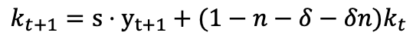
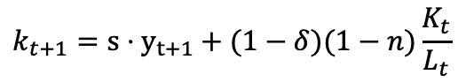
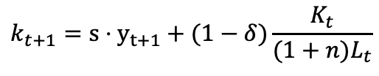
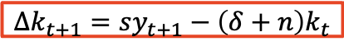
$$K_{t+1}={sY}_{t+1}+(1−δ)K_{t}$$
$$k_{t+1}={s⋅y}_{t+1}+k_{t}+(−n−δ)k_{t}$$
$$\frac{K_{t+1}}{L_{t+1}}=s\frac{Y_{t+1}}{L_{t+1 }}+(1−δ)\frac{K_{t}}{L_{t+1}}$$
$$k_{t+1}−k_{t}={s⋅y}_{t+1}+(−n−δ)k_{t}$$
$$k_{t+1}={s⋅y}_{t+1}+(1−δ)\frac{K_{t}}{{(1+n)L}_{t}}$$
$$Δk_{t+1}=sy_{t+1}−\left(δ+n\right)k_{t}$$
$$k_{t+1}={s⋅y}_{t+1}+(1−δ)(1−n)\frac{K_{t}}{L_{t}}$$
$$k_{t+1}={s⋅y}_{t+1}+(1−n−δ−δn)k_{t}$$

Slide 18
Capital Accumulation
Notation
$$ΔK=I−δK$$
$$Δ\frac{K}{L}=s⋅\frac{Y}{L}−δ\frac{K}{L}−n\frac{K}{L}$$
$K$= capital
$$I=s⋅Y$$
$L$= labor
$$ΔK=sY−δK$$
To prove this, we need calculus and time variable capital: $K(t)$
$I$= investment
$s$= saving rate
$$Δ\frac{K}{L}=s\frac{Y}{L}−\left(δ+n\right)\frac{K}{L}$$
$δ$= depreciation rate
$n$= population growth rate

Slide 19
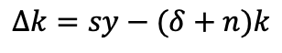
Capital Accumulation
Notation
$$ΔK=I−δK$$
$$Δ\frac{K}{L}=s⋅\frac{Y}{L}−δ\frac{K}{L}−n\frac{K}{L}$$
$K$= capital
$$I=s⋅Y$$
$L$= labor
$$ΔK=sY−δK$$
To prove this, we need calculus and time variable capital: $K(t)$
$I$= investment
$s$= saving rate
$$Δ\frac{K}{L}=s\frac{Y}{L}−\left(δ+n\right)\frac{K}{L}$$
$δ$= depreciation rate
$n$= population growth rate
$$Δk=sy−(δ+n)k$$

Slide 20
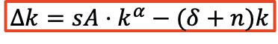
Capital Accumulation
Notation
$$ΔK=I−δK$$
$$Δ\frac{K}{L}=s⋅\frac{Y}{L}−δ\frac{K}{L}−n\frac{K}{L}$$
$K$= capital
$$I=s⋅Y$$
$L$= labor
$$ΔK=sY−δK$$
To prove this, we need calculus and time variable capital: $K(t)$
$I$= investment
$s$= saving rate
$$Δ\frac{K}{L}=s\frac{Y}{L}−\left(δ+n\right)\frac{K}{L}$$
$δ$= depreciation rate
$n$= population growth rate
$$Δk=sy−(δ+n)k$$
$$Δk=sA⋅k^{α}−(δ+n)k$$

Slide 21
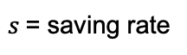
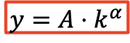
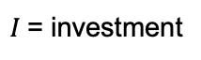
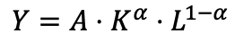
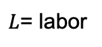
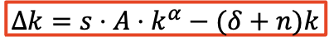
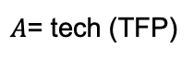
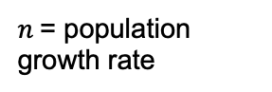
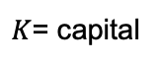
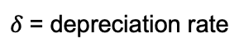
Solow Swan Model – Solution
Cobb-Douglas production function
Capital accumulation
Notation
$$Y=A⋅K^{α}⋅L^{1−α}$$
$A$= tech (TFP)
$$y=A⋅k^{α}$$
$$Δk=s⋅A⋅k^{α}−(δ+n)k$$
$K$= capital
$L$= labor
$I$= investment
$s$= saving rate
$δ$= depreciation rate
$n$= population growth rate

Slide 22

Solow Swan Model – Solution
Cobb-Douglas production function
Capital accumulation
Notation
$$Y=A⋅K^{α}⋅L^{1−α}$$
$A$= tech (TFP)
$$y=A⋅k^{α}$$
$$Δk=s⋅A⋅k^{α}−(δ+n)k$$
$K$= capital
$L$= labor
$I$= investment
Steady state $(Δk=0)$
$s$= saving rate
$δ$= depreciation rate
$n$= population growth rate

Slide 23
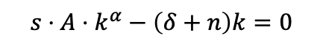
Solow Swan Model – Solution
Cobb-Douglas production function
Capital accumulation
Notation
$$Y=A⋅K^{α}⋅L^{1−α}$$
$A$= tech (TFP)
$$y=A⋅k^{α}$$
$$Δk=s⋅A⋅k^{α}−(δ+n)k$$
$K$= capital
$L$= labor
$I$= investment
Steady state $(Δk=0)$
$s$= saving rate
$$s⋅A⋅k^{α}−\left(δ+n\right)k=0$$
$δ$= depreciation rate
$n$= population growth rate

Slide 24

Solow Swan Model – Solution
Cobb-Douglas production function
Capital accumulation
Notation
$$Y=A⋅K^{α}⋅L^{1−α}$$
$A$= tech (TFP)
$$y=A⋅k^{α}$$
$$Δk=s⋅A⋅k^{α}−(δ+n)k$$
$K$= capital
$L$= labor
$I$= investment
Steady state $(Δk=0)$
$s$= saving rate
$$s⋅A⋅k^{α}−\left(δ+n\right)k=0$$
$δ$= depreciation rate
$$s⋅A⋅k^{α}=\left(δ+n\right)k$$
$n$= population growth rate

Slide 25
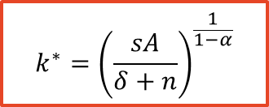
Solow Swan Model – Solution
Cobb-Douglas production function
Capital accumulation
Notation
$$Y=A⋅K^{α}⋅L^{1−α}$$
$A$= tech (TFP)
$$y=A⋅k^{α}$$
$$Δk=s⋅A⋅k^{α}−(δ+n)k$$
$K$= capital
$L$= labor
$I$= investment
Steady state $(Δk=0)$
$s$= saving rate
$$s⋅A⋅k^{α}−\left(δ+n\right)k=0$$
$δ$= depreciation rate
$$s⋅A⋅k^{α}=\left(δ+n\right)k$$
$n$= population growth rate
Steady state capital
$$k^{∗}={\left(\frac{sA}{δ+n}\right)}^{\frac{1}{1−α}}$$

Slide 26
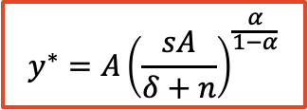

Solow Swan Model – Solution
Cobb-Douglas production function
Capital accumulation
Notation
$$Y=A⋅K^{α}⋅L^{1−α}$$
$A$= tech (TFP)
$$y=A⋅k^{α}$$
$$Δk=s⋅A⋅k^{α}−(δ+n)k$$
$K$= capital
$L$= labor
$I$= investment
Steady state $(Δk=0)$
$s$= saving rate
$$s⋅A⋅k^{α}−\left(δ+n\right)k=0$$
$δ$= depreciation rate
$$s⋅A⋅k^{α}=\left(δ+n\right)k$$
$n$= population growth rate
Steady state capital
Steady state output
$$k^{∗}={\left(\frac{sA}{δ+n}\right)}^{\frac{1}{1−α}}$$
$$y^{∗}=A{\left(\frac{sA}{δ+n}\right)}^{\frac{α}{1−α}}$$

Slide 27
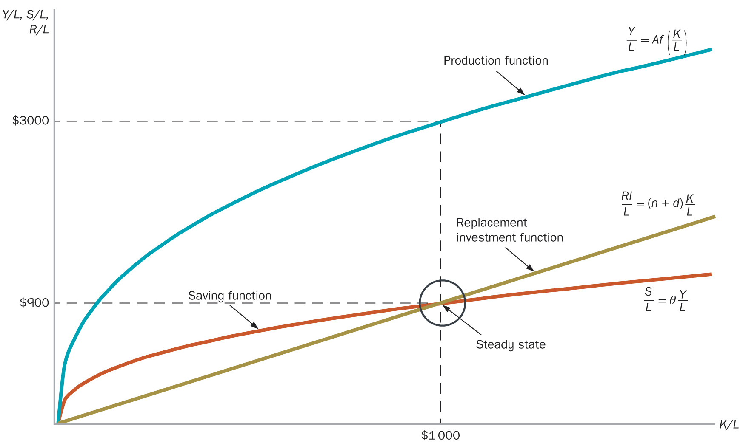
Solow Swan Model - Diagram

Slide 28
Tutorial Questions

Slide 29
Question 2 (Last week)
Richland’s real GDP per person is $10,000, and Poorland’s real GDP per person is $5000. However, Richland’s real GDP is growing at 1% per year and Poorland’s is growing at 3 per cent per year. Compare real GDP per person in the two countries after 10 years and after 0 years. Approximately how many years will it take Poorland to catch up with Richland?

Slide 30
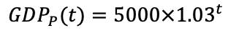
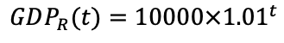
Question 2 (Last week)
Richland’s real GDP per person is $10,000, and Poorland’s real GDP per person is $5000. However, Richland’s real GDP is growing at 1% per year and Poorland’s is growing at 3 per cent per year. Compare real GDP per person in the two countries after 10 years and after 0 years. Approximately how many years will it take Poorland to catch up with Richland?
$$GDP_{R}(t)=10000×{1.01}^{t}$$
$$GDP_{P}(t)=5000×{1.03}^{t}$$

Slide 31
Question 2 (Last week)
Richland’s real GDP per person is $10,000, and Poorland’s real GDP per person is $5000. However, Richland’s real GDP is growing at 1% per year and Poorland’s is growing at 3 per cent per year. Compare real GDP per person in the two countries after 10 years and after 0 years. Approximately how many years will it take Poorland to catch up with Richland?
$$GDP_{R}(t)=10000×{1.01}^{t}$$
$$GDP_{P}(t)=5000×{1.03}^{t}$$
After 10 years
$$GDP_{R}\left(10\right)=10000×{1.01}^{10}=11,046$$
$$GDP_{P}\left(10\right)=5000×{1.03}^{10}=6,720$$

Slide 32
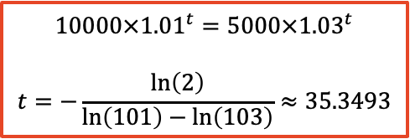
Question 2 (Last week)
Richland’s real GDP per person is $10,000, and Poorland’s real GDP per person is $5000. However, Richland’s real GDP is growing at 1% per year and Poorland’s is growing at 3 per cent per year. Compare real GDP per person in the two countries after 10 years and after 0 years. Approximately how many years will it take Poorland to catch up with Richland?
$$GDP_{R}(t)=10000×{1.01}^{t}$$
Catch up
$$GDP_{P}(t)=5000×{1.03}^{t}$$
$$10000×{1.01}^{t}=5000×{1.03}^{t}$$
$$t=−\frac{\ln\left(2\right)}{\ln\left(101\right)−\ln\left(103\right)}≈35.3493$$
After 10 years
$$GDP_{R}\left(10\right)=10000×{1.01}^{10}=11,046$$
$$GDP_{P}\left(10\right)=5000×{1.03}^{10}=6,720$$

Slide 33
Question 1
How would you respond to the following argument: ‘Economic theory makes no sense. For example, poor countries have very little capital. But capital has diminishing marginal productivity. So, in poor countries, the marginal productivity of
capital must be high. But then if capital is so productive in those countries, why is
everyone not there rich?’

Slide 34
Question 1
How would you respond to the following argument: ‘Economic theory makes no sense. For example, poor countries have very little capital. But capital has diminishing marginal productivity. So, in poor countries, the marginal productivity of
capital must be high. But then if capital is so productive in those countries, why is
everyone not there rich?’

Slide 35
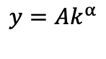
Question 1
How would you respond to the following argument: ‘Economic theory makes no sense. For example, poor countries have very little capital. But capital has diminishing marginal productivity. So, in poor countries, the marginal productivity of
capital must be high. But then if capital is so productive in those countries, why is
everyone not there rich?’
$$y=Ak^{α}$$

Slide 36
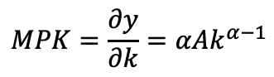
Question 1
How would you respond to the following argument: ‘Economic theory makes no sense. For example, poor countries have very little capital. But capital has diminishing marginal productivity. So, in poor countries, the marginal productivity of
capital must be high. But then if capital is so productive in those countries, why is
everyone not there rich?’
$$y=Ak^{α}$$
$$MPK=\frac{∂y}{∂k}=αAk^{α−1}$$

Slide 37
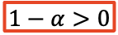
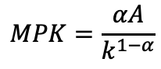

Question 1
How would you respond to the following argument: ‘Economic theory makes no sense. For example, poor countries have very little capital. But capital has diminishing marginal productivity. So, in poor countries, the marginal productivity of
capital must be high. But then if capital is so productive in those countries, why is
everyone not there rich?’
$$y=Ak^{α}$$
$$MPK=\frac{∂y}{∂k}=αAk^{α−1}$$
Since $α<1⟹α−1<0$
$$MPK=\frac{αA}{k^{1−α}}$$
$$1−α>0$$

Slide 38

Question 1
How would you respond to the following argument: ‘Economic theory makes no sense. For example, poor countries have very little capital. But capital has diminishing marginal productivity. So, in poor countries, the marginal productivity of
capital must be high. But then if capital is so productive in those countries, why is
everyone not there rich?’
$$y=Ak^{α}$$
$$k↑ ⟹MPK↓$$
$$MPK=\frac{∂y}{∂k}=αAk^{α−1}$$
Since $α<1⟹α−1<0$
$$MPK=\frac{αA}{k^{1−α}}$$
$$1−α>0$$

Slide 39

Question 1
How would you respond to the following argument: ‘Economic theory makes no sense. For example, poor countries have very little capital. But capital has diminishing marginal productivity. So, in poor countries, the marginal productivity of
capital must be high. But then if capital is so productive in those countries, why is
everyone not there rich?’
$$y=Ak^{α}$$
$$k↑ ⟹MPK↓$$
$$MPK=\frac{∂y}{∂k}=αAk^{α−1}$$
Note! Income depends on $y$, and $y$ depends on the amount of $k$, rather than $MPK$
Since $α<1⟹α−1<0$
$$MPK=\frac{αA}{k^{1−α}}$$
$$1−α>0$$

Slide 40
Question 1
How would you respond to the following argument: ‘Economic theory makes no sense. For example, poor countries have very little capital. But capital has diminishing marginal productivity. So, in poor countries, the marginal productivity of
capital must be high. But then if capital is so productive in those countries, why is
everyone not there rich?’
$$y=Ak^{α}$$
$$k↑ ⟹MPK↓$$
$$MPK=\frac{∂y}{∂k}=αAk^{α−1}$$
Note! Income depends on $y$, and $y$ depends on the amount of $k$, rather than $MPK$
Since $α<1⟹α−1<0$
$$MPK=\frac{αA}{k^{1−α}}$$
High MPK attracts more investment, increases K in the long-run, thus higher living standard in the long-run
$$1−α>0$$

Slide 41

Question 2
The Swan-Solow neoclassical growth model can be represented by the following equation, $Δk_{t+1}=sf\left(k\right)−\left(δ+n\right)k$
a. What do you understand by the above equation? List all the assumptions used to derive the above equation. Represent it graphically

Slide 42

Question 2
The Swan-Solow neoclassical growth model can be represented by the following equation, $Δk_{t+1}=sf\left(k\right)−\left(δ+n\right)k$
a. What do you understand by the above equation? List all the assumptions used to derive the above equation. Represent it graphically
$$Δk_{t+1}=sf\left(k\right)−\left(δ+n\right)k$$
Saving
Depreciation + increase in population

Slide 43

Question 2
The Swan-Solow neoclassical growth model can be represented by the following equation, $Δk_{t+1}=sf\left(k\right)−\left(δ+n\right)k$
a. What do you understand by the above equation? List all the assumptions used to derive the above equation. Represent it graphically
$$Δk_{t+1}=sf\left(k\right)−\left(δ+n\right)k$$
Saving
Depreciation + increase in population

Slide 44
Question 2
The Swan-Solow neoclassical growth model can be represented by the following equation, $Δk_{t+1}=sf\left(k\right)−\left(δ+n\right)k$
b. What is meant by the concept of the steady-state or balanced growth, in this
model? What bearing does the concept of the steady-state have on the proposition that an economy’s long-run rate of growth is zero?

Slide 45


Question 2
The Swan-Solow neoclassical growth model can be represented by the following equation, $Δk_{t+1}=sf\left(k\right)−\left(δ+n\right)k$
b. What is meant by the concept of the steady-state or balanced growth, in this
model? What bearing does the concept of the steady-state have on the proposition that an economy’s long-run rate of growth is zero?
$$k^{∗}={\left(\frac{sA}{δ+n}\right)}^{\frac{1}{1−α}}$$
$$y^{∗}=A{\left(\frac{sA}{δ+n}\right)}^{\frac{α}{1−α}}$$

Slide 46
Question 2
The Swan-Solow neoclassical growth model can be represented by the following equation, $Δk_{t+1}=sf\left(k\right)−\left(δ+n\right)k$
b. What is meant by the concept of the steady-state or balanced growth, in this
model? What bearing does the concept of the steady-state have on the proposition that an economy’s long-run rate of growth is zero?
The economy stops at the steady state
$$k^{∗}={\left(\frac{sA}{δ+n}\right)}^{\frac{1}{1−α}}$$
$$y^{∗}=A{\left(\frac{sA}{δ+n}\right)}^{\frac{α}{1−α}}$$
Only TFP can change long-run output & growth

Slide 47
Question 3
Show, using diagrams, the effects on output of an increase in the marginal propensity to save in the (i) basic Keynesian model (the 45-degree diagram) and (ii) the Solow-Swan model. Explain any differences

Slide 48


Question 3
Show, using diagrams, the effects on output of an increase in the marginal propensity to save in the (i) basic Keynesian model (the 45-degree diagram) and (ii) the Solow-Swan model. Explain any differences

Slide 49


Question 3
Show, using diagrams, the effects on output of an increase in the marginal propensity to save in the (i) basic Keynesian model (the 45-degree diagram) and (ii) the Solow-Swan model. Explain any differences

Slide 50
Question 3
Show, using diagrams, the effects on output of an increase in the marginal propensity to save in the (i) basic Keynesian model (the 45-degree diagram) and (ii) the Solow-Swan model. Explain any differences
Why so different?

Slide 51
Question 3
Show, using diagrams, the effects on output of an increase in the marginal propensity to save in the (i) basic Keynesian model (the 45-degree diagram) and (ii) the Solow-Swan model. Explain any differences
Why so different?
Short vs. Long-run

Slide 52

Question 4
Consider two countries ‘Milkie’ and ‘Cookie’. The two countries have identical per
capita production function, $y = Ak^{0.5}$, with initially the same level of technology, $A=1$.Also, assume that the saving rate is $s=0.2$for ‘Milkie’ and $s=0.3$for ‘Cookie’, respectively, while the two countries have identical population growth and depreciation rates both equal to 0.1.
a. Which country has a higher steady state income per capita? Determine the steady state income per capita for each country. Which country has a higher steady state growth rate in per capita income? Why?

Slide 53



Question 4
Consider two countries ‘Milkie’ and ‘Cookie’. The two countries have identical per
capita production function, $y = Ak^{0.5}$, with initially the same level of technology, $A=1$.Also, assume that the saving rate is $s=0.2$for ‘Milkie’ and $s=0.3$for ‘Cookie’, respectively, while the two countries have identical population growth and depreciation rates both equal to 0.1.
a. Which country has a higher steady state income per capita? Determine the steady state income per capita for each country. Which country has a higher steady state growth rate in per capita income? Why?
$$k^{∗}={\left(\frac{sA}{δ+n}\right)}^{\frac{1}{1−α}}$$
$$n=0.1, δ=0.1, A=1$$
$$s_{M}=0.2, s_{C}=0.3,$$
$$y^{∗}=A{\left(\frac{sA}{δ+n}\right)}^{\frac{α}{1−α}}$$

Slide 54


Question 4
Consider two countries ‘Milkie’ and ‘Cookie’. The two countries have identical per
capita production function, $y = Ak^{0.5}$, with initially the same level of technology, $A=1$.Also, assume that the saving rate is $s=0.2$for ‘Milkie’ and $s=0.3$for ‘Cookie’, respectively, while the two countries have identical population growth and depreciation rates both equal to 0.1.
a. Which country has a higher steady state income per capita? Determine the steady state income per capita for each country. Which country has a higher steady state growth rate in per capita income? Why?
$$k^{∗}={\left(\frac{sA}{δ+n}\right)}^{\frac{1}{1−α}}$$
$$n=0.1, δ=0.1, A=1$$
$$s_{M}=0.2, s_{C}=0.3,$$
$$y^{∗}=A{\left(\frac{sA}{δ+n}\right)}^{\frac{α}{1−α}}$$
$$k_{M}^{∗}={\left(\frac{0.2}{0.1+0.1}\right)}^{\frac{1}{1−0.5}}=1$$
$$y=1$$

Slide 55

Question 4
Consider two countries ‘Milkie’ and ‘Cookie’. The two countries have identical per
capita production function, $y = Ak^{0.5}$, with initially the same level of technology, $A=1$.Also, assume that the saving rate is $s=0.2$for ‘Milkie’ and $s=0.3$for ‘Cookie’, respectively, while the two countries have identical population growth and depreciation rates both equal to 0.1.
a. Which country has a higher steady state income per capita? Determine the steady state income per capita for each country. Which country has a higher steady state growth rate in per capita income? Why?
$$k^{∗}={\left(\frac{sA}{δ+n}\right)}^{\frac{1}{1−α}}$$
$$n=0.1, δ=0.1, A=1$$
$$s_{M}=0.2, s_{C}=0.3,$$
$$y^{∗}=A{\left(\frac{sA}{δ+n}\right)}^{\frac{α}{1−α}}$$
$$k_{M}^{∗}={\left(\frac{0.2}{0.1+0.1}\right)}^{\frac{1}{1−0.5}}=1$$
$$y=1$$
$$k_{C}^{∗}={\left(\frac{0.3}{0.1+0.1}\right)}^{\frac{1}{1−0.5}}=\frac{9}{4}$$
$$y=\frac{3}{2}$$

Slide 56
Question 4
Consider two countries ‘Milkie’ and ‘Cookie’. The two countries have identical per
capita production function, $y = Ak^{0.5}$, with initially the same level of technology, $A=1$.Also, assume that the saving rate is $s=0.2$for ‘Milkie’ and $s=0.3$for ‘Cookie’, respectively, while the two countries have identical population growth and depreciation rates both equal to 0.1.
a. Which country has a higher steady state income per capita? Determine the steady state income per capita for each country. Which country has a higher steady state growth rate in per capita income? Why?
$$k^{∗}={\left(\frac{sA}{δ+n}\right)}^{\frac{1}{1−α}}$$
$$n=0.1, δ=0.1, A=1$$
$$s_{M}=0.2, s_{C}=0.3,$$
$$y^{∗}=A{\left(\frac{sA}{δ+n}\right)}^{\frac{α}{1−α}}$$
$$k_{M}^{∗}={\left(\frac{0.2}{0.1+0.1}\right)}^{\frac{1}{1−0.5}}=1$$
$$y=1$$
$$k_{C}^{∗}={\left(\frac{0.3}{0.1+0.1}\right)}^{\frac{1}{1−0.5}}=\frac{9}{4}$$
$$y=\frac{3}{2}$$
More saving → More capital → Higher Output

Slide 57




Question 4
Consider two countries ‘Milkie’ and ‘Cookie’. The two countries have identical per
capita production function, $y = Ak^{0.5}$, with initially the same level of technology, $A=1$.Also, assume that the saving rate is $s=0.2$for ‘Milkie’ and $s=0.3$for ‘Cookie’, respectively, while the two countries have identical population growth and depreciation rates both equal to 0.1.
b. Assume now that ‘Milkie’ experiences a productivity boom facing a higher
value for $A$, $A=2$ now for this country. All else remaining the same, how
would it affect the steady state income for ‘Milkie’? Determine the new
steady state income per capita for ‘Milkie’.
$$n=0.1, δ=0.1, A=2$$
$$s_{M}=0.2, s_{C}=0.3,$$
$$k^{∗}={\left(\frac{sA}{δ+n}\right)}^{\frac{1}{1−α}}$$
$$y^{∗}=A{\left(\frac{sA}{δ+n}\right)}^{\frac{α}{1−α}}$$

Slide 58

Question 4
Consider two countries ‘Milkie’ and ‘Cookie’. The two countries have identical per
capita production function, $y = Ak^{0.5}$, with initially the same level of technology, $A=1$.Also, assume that the saving rate is $s=0.2$for ‘Milkie’ and $s=0.3$for ‘Cookie’, respectively, while the two countries have identical population growth and depreciation rates both equal to 0.1.
b. Assume now that ‘Milkie’ experiences a productivity boom facing a higher
value for $A$, $A=2$ now for this country. All else remaining the same, how
would it affect the steady state income for ‘Milkie’? Determine the new
steady state income per capita for ‘Milkie’.
$$n=0.1, δ=0.1, A=2$$
$$s_{M}=0.2, s_{C}=0.3,$$
$$k^{∗}={\left(\frac{sA}{δ+n}\right)}^{\frac{1}{1−α}}$$
$$k_{M}^{∗}={\left(\frac{0.2∗2}{0.1+0.1}\right)}^{\frac{1}{1−0.5}}=4$$
$$y=4$$
$$y^{∗}=A{\left(\frac{sA}{δ+n}\right)}^{\frac{α}{1−α}}$$

Slide 59

Question 5
Consider the following table, showing population projections for Australia
Using the Solow-Swan diagram, and assuming everything else is held constant, what will be the effect on the economy’s steady-state level of per capita GDP of the trend displayed in the table? Does this finding have any implications for other countries in our region – discuss.

Slide 60
Question 5
Consider the following table, showing population projections for Australia
Using the Solow-Swan diagram, and assuming everything else is held constant, what will be the effect on the economy’s steady-state level of per capita GDP of the trend displayed in the table? Does this finding have any implications for other countries in our region – discuss.

Slide 61

Question 5
Consider the following table, showing population projections for Australia
Using the Solow-Swan diagram, and assuming everything else is held constant, what will be the effect on the economy’s steady-state level of per capita GDP of the trend displayed in the table? Does this finding have any implications for other countries in our region – discuss.

Slide 62




Question 6
Consider the following table. Using a Solow-Swan diagram, choose any one European country and any one Asian country and compare and contrast the factors that have contributed to growth.
$$k^{∗}={\left(\frac{sA}{δ+n}\right)}^{\frac{1}{1−α}}$$
$$y^{∗}=A{\left(\frac{sA}{δ+n}\right)}^{\frac{α}{1−α}}$$

Slide 63
Question 6
Consider the following table. Using a Solow-Swan diagram, choose any one European country and any one Asian country and compare and contrast the factors that have contributed to growth.
$$k^{∗}={\left(\frac{sA}{δ+n}\right)}^{\frac{1}{1−α}}$$
$$y^{∗}=A{\left(\frac{sA}{δ+n}\right)}^{\frac{α}{1−α}}$$
Europe: Higher TFP growth (upwards movement on the production function)
Asia: Higher capital growth (movement along a given production function)

Slide 64
Questions?

